Slide 1
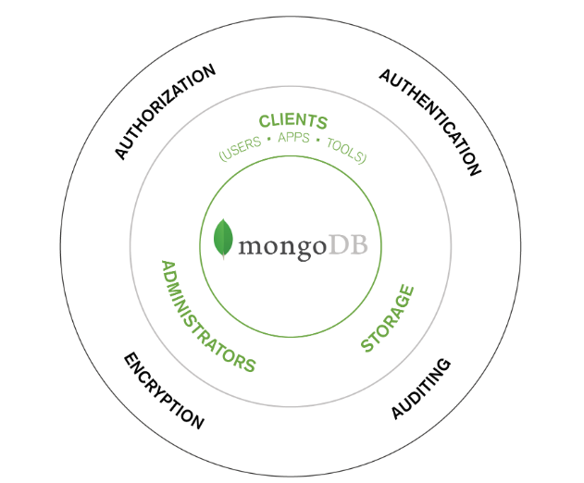
Security Implementation in MongoDb
Otto Negron

Slide 2

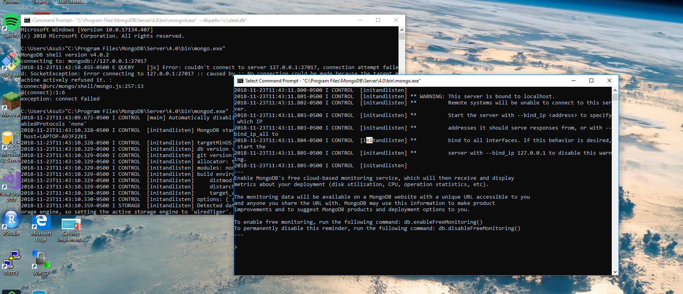
Run MongoDb
To Run MongoDb:
Open CommandPrompt and paste:
"C:\Program Files\MongoDB\Server\3.2\bin\mongod.exe“
Open a second CommandPrompt and paste:
"C:\Program Files\MongoDB\Server\4.0\bin\mongo.exe"

Slide 3
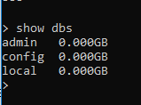
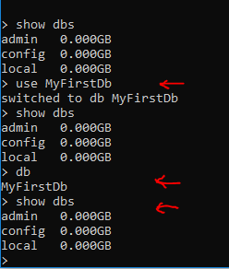
MongoDb Basics
1. Show databases
2. Create a database (need to insert a document)

Slide 4
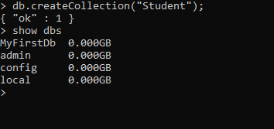
Mongodb basics – create collection
3. Create a collection (table)

Slide 5
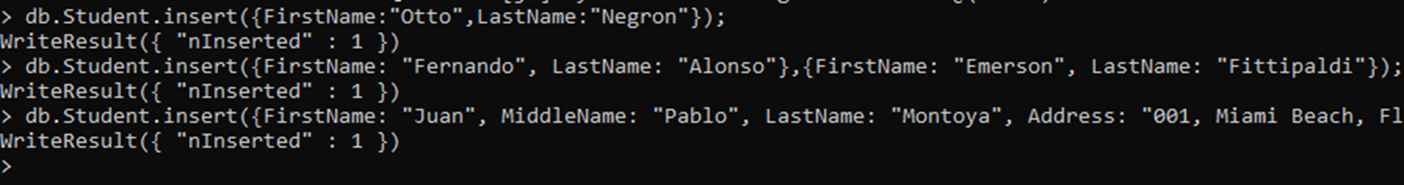
Mongodb basics
4. Create a document (record)

Slide 6
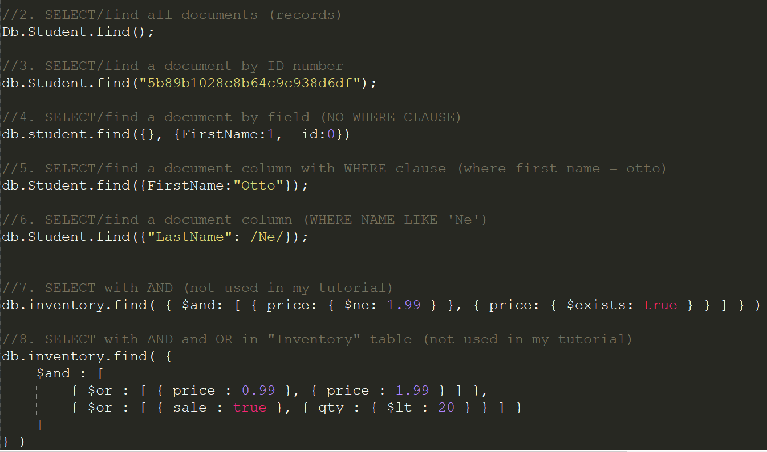
Mongodb basics: find a document

Slide 7
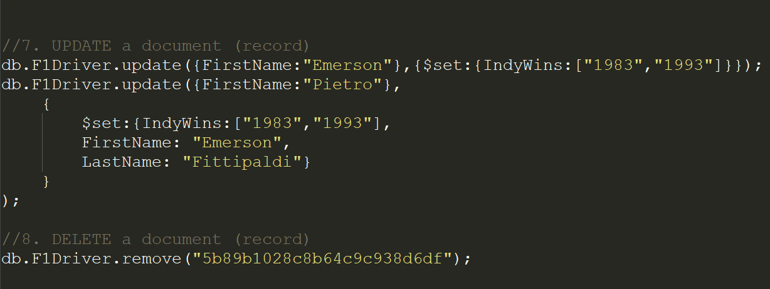
Mongodb basics: update/delete

Slide 8
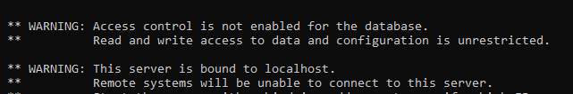
Authentication AND AUTHORIZATION
When you start MongoDB for the first time, you don’t have authentication enabled.
Must create a user with admin privileges before enabling authentication (or you will be locked out)

Slide 9
Authentication options
MongoDb Community
SCRAM SHA-1 (Default) = Secure Hash Algorithm
x.509 Certificate Authentication.
----------------------------------------------------------
Enterprise Options
LDAP (important to use LDAP. MongoDb does not support password policy like SQL Server. Instead, manage passwords with Remote Active Directory server)
Kerberos

Slide 10
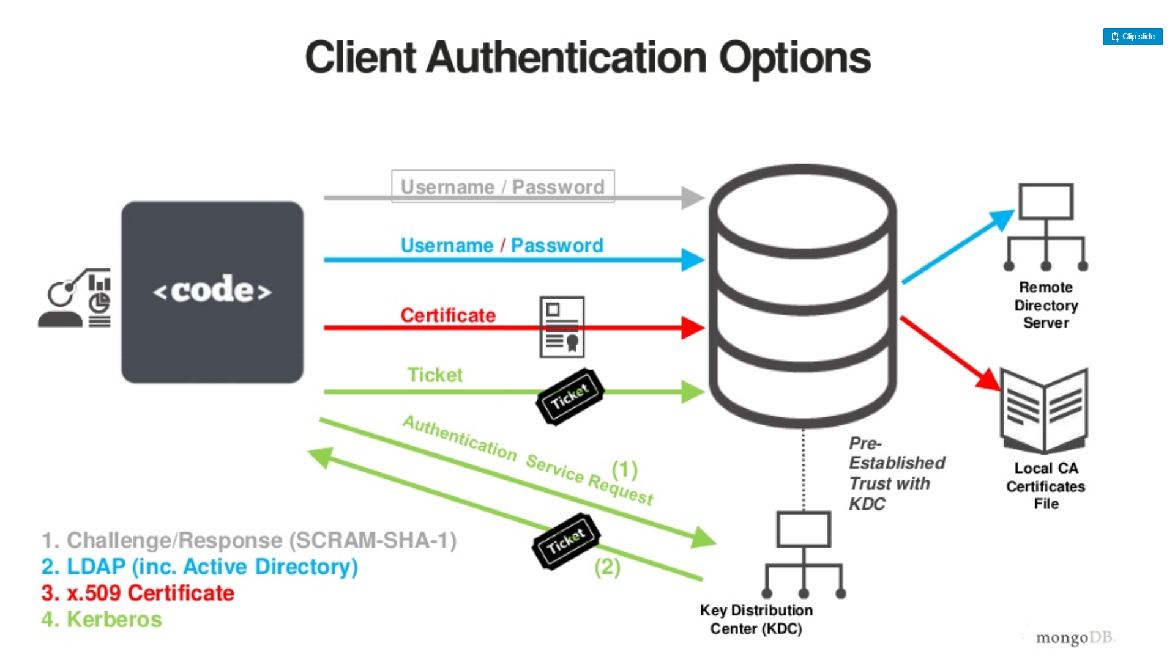
Notes:
SCRAM SHA-1 = Hash the password so it is not plain text in case it is captured by someone.
LDAP = The simple authentication method has the LDAP client send the username (as a LDAP distinguished name) and password (in clear text) to the LDAP server. The LDAP server looks up the object with that username in the directory, compares the password provided to the password(s) stored with the object, and authenticates the connection if they match. Example: logging in with your computer to an internal network such as Cummins.
X.509 =
Kerberos = Client will encrypt a package with identifying information. The key that encrypts the package is the password. The password is not transmitted. The package/ticket is sent to the KDC, which has a copy of that password and will use it to decrypt the ticket. If successful, the KDC will send back a ticket to the client that only the FileServer can decrypt with its own password. No passwords are ever transmitted.

Slide 11
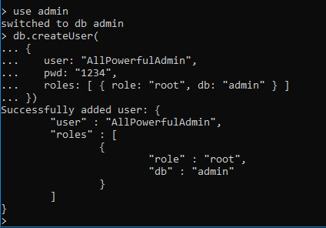
Enabling authentication
Create a user with ROOT privileges (careful not to lock yourself).
Restart MONGOD to run with –AUTH
MONGOD = MongoDb Engine and back processes.
Maintain secure server or malicious user could run with “-- auth” off.

Slide 12
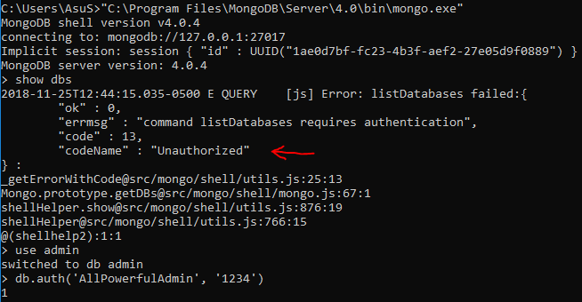

Slide 13
Authorization OPTIONS (ROLES)
Built-in roles
Read
ReadWrite
DbAdmin
DbOwner
UserAdmin
UserAdminAnyDatabase
root
Note: Last 3 can become SuperUser if placed in the admin database.

Slide 14
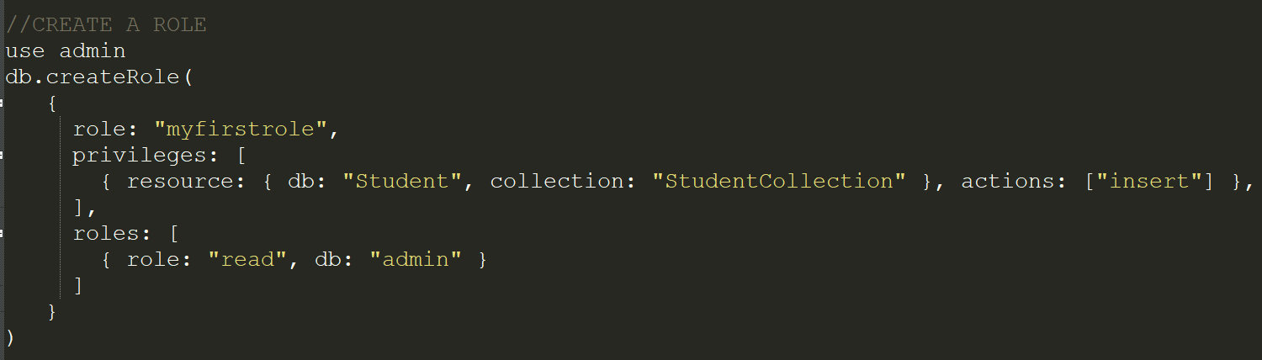
Authorization options (roles)
Create a custom role
Notes:
https://docs.mongodb.com/manual/tutorial/manage-users-and-roles/
https://docs.mongodb.com/manual/reference/privilege-actions/

Slide 15
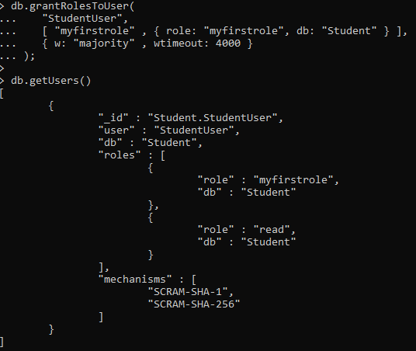
Authorization options (ROLES)
Grant a role

Slide 16
Row & Field security
Access control is only available at the collection level (table level).
no way to grant privileges to a user to read/write rows and columns.
Lowest level control is at the “Collection Level”. Collection privileges can be granted with a user-defined role.
SQL Server vs MongoDB
Sql server: CREATE SECURITY POLICY function, which works with predicates.
In MongoDb, this is not available.

Slide 17
vpd IN MONGODB? No triggers!
NOTE TO MYSELF…. NOT SURE IF I HAVE TIME TO IMPLEMENT
create a Subjects table.
create a Students view.
create a user that can read Subjects table but no privilege to see the Students view.
create a user with a privilege to read Student view.

Slide 18
Ip binding

Slide 19
Encryption at rest
Only available in MongoDB Enterprise and MongoDB Atlas (Cloud).
MongoDB Enterprise:
WiredTiger Storage Engine:
all data files are fully encrypted from a filesystem perspective, and data only exists in an unencrypted state in memory and during transmission.
Uses the AES-256-CBC: 256-bit Advanced Encryption Standard in Cipher Block Chaining mode
MongoDB Atlas:
Encryption enabled with a checkbox (Option: Use Encrypted Storage Volumes)
SQL Server vs Mongo Comparison: Column encryption not available ☹

Slide 20

Encryption behind the scenes
Generating a master key.
Generating keys for each database.
Encrypting data with the database keys.
Encrypting the database keys with the master key.

Slide 21
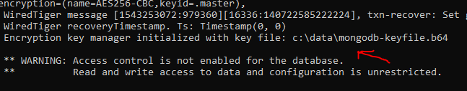
Encryption (steps)
Create a textfile with a string of 32 characters. This is your master key.
Encode the key in base64 with these windows commands:
certutil -encode mongodb-keyfile.txt tmp.b64 && findstr /v /c:- tmp.b64 > mongodb-keyfile.b64
Change the file permissions to Read and Write.
Make sure the DbPath is empty. Will not encrypt previous databases.
Start mongod (note: --auth after encryption is working. Try later)
cd c:\Program Files\MongoDB\Server\4.0\bin
mongod --port 27017 --dbpath "c:\data\db" --enableEncryption --encryptionKeyFile "c:\data\mongodb-keyfile.b64"

Slide 22
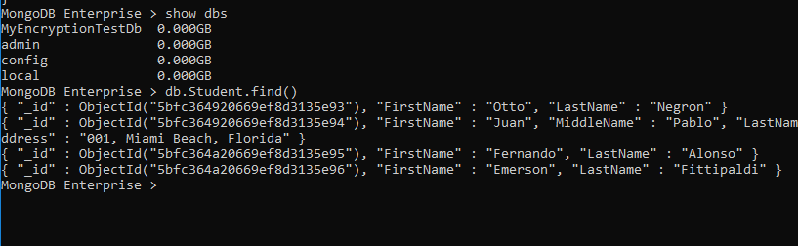
Encryption (testing)
[initandlisten] WiredTiger error (0)
This may be due to the database files being encrypted, being from an older version or due to corruption on disk Raw:
You should confirm that you have opened the database with the correct options including all encryption and compression options
2018-11-26T13:52:12.175-0500 W STORAGE [initandlisten] Failed to start up WiredTiger under any compatibility version.
Create a database while encryption is Enabled.
Restart MONGOD without Encryption option.
Try to login to database

Slide 23
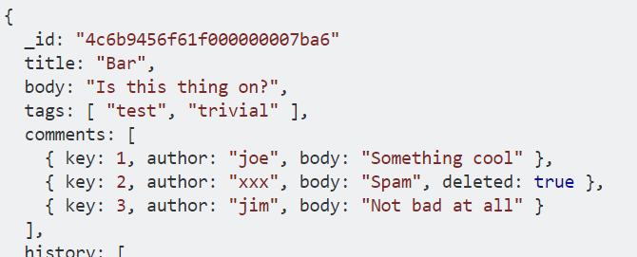
Auditing
No triggers… therefore, cannot easily build an auditing table. Other possibilities include:
Saving changes within the document.
Using an application layer function as a trigger and saving history in another table.
https://stackoverflow.com/questions/3507624/mongodb-nosql-keeping-document-change-history
Alternative: AUDITING TRAIL.
mongod --dbpath data/db --auditDestination file --auditFormat BSON --auditPath data/db/auditLog.bson

Slide 24
auditing
Viewing the audit trail from BSON file, go to a new command line interface:
cd c:\Program Files\MongoDB\Server\4.0\bin
bsondump "c:\data\db\auditLog.bson“
Filters can also be applied on the auditing (--auditFilter command)
By operation (drop collection, drop database…)
By authentication actions
By Authorization role
By read and write operation

Slide 25
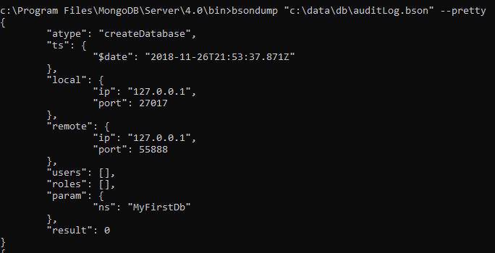

Slide 26
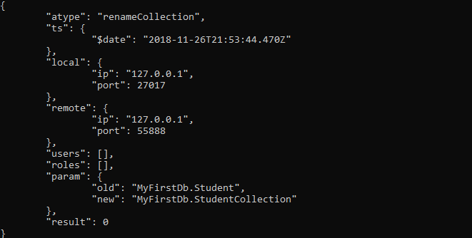

Slide 27
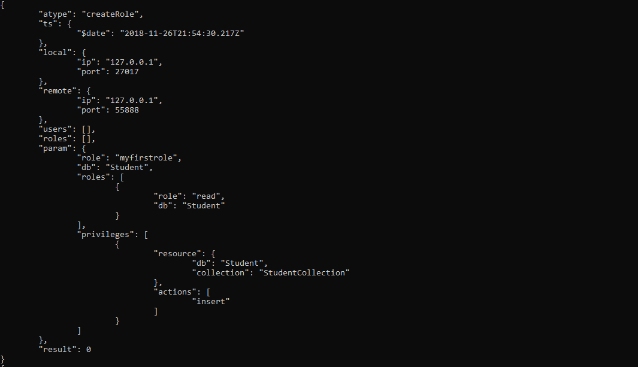

Slide 28
injection
No stored procedures
Very easy to inject.

